Slide 1

Grip Force Prediction of Microgripper
Presented by:
Aryan Jha - BTECH/10344/23
Saurav Khyalia - BTECH/10331/23
Arif Ahmad - BTECH/10333/23
DEPARTMENT OF ELECTRONICS AND COMMUNICATION ENGINEERING
BIRLA INSTITUTE OF TECHNOLOGY , MESRA
Under the Supervision of:
Dr. Neela Chattoraj

Slide 2
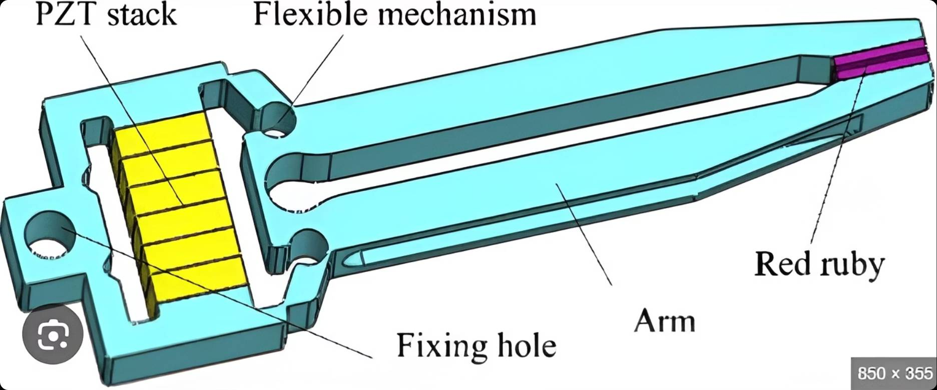
Project Overview:
A microgripper is a very small gripping device used to hold, manipulate, or assemble tiny objects that are too small for human hands or conventional tools.
Uses:
→ Micro-electromechanical systems (MEMS), biotechnology, microsurgery, and precision manufacturing.
→Main Parts of a Microgripper:
Arms (Jaws) :The two movable parts that open and close Used to hold the tiny object
Actuator :The driving mechanism that moves the arms ,converts electrical energy into mechanical motion
Anchor: Fixed support that holds the device in place Provides stability during gripping
Surrogate ML Model: A trained regression algorithm used to bypass FEA computational latency, providing sub-millisecond force estimation.

Slide 3




Workflow Architecture
Guiding Principle
A microgripper works like a mini robotic hand: Electrical signal is given to the actuator Actuator produces motion Arms move inward or outward Object is gripped gently and precisely
The microgripper operates on the inverse piezoelectric effect. When a voltage is applied to the active PZT-5H actuator at the base, the material physically expands. Because this active "muscle" is bonded to a passive Polysilicon arm that does not expand, it creates uneven internal mechanical stress. This uneven expansion forces the entire cantilever structure to bend laterally. This precision bending provides the controlled microscopic force needed to grip delicate objects
ML Optimization: While the inverse piezoelectric effect drives the physical bending, a Machine Learning model learns the non-linear relationship between Vin, geometry, and RFx to predict outcomes instantly without re-running simulations.

Slide 4
Introduction and Problems to Tackle
The project aims to develop a predictive system for estimating the gripping force of a piezoelectric microgripper by using simulation data generated from COMSOL Multiphysics. The finalized system utilizes a Random Forest regressor model to map thousands of parametric combinations. This solves the primary bottleneck of 15-minute COMSOL solve times, enabling instant, noise-resilient force prediction for Micro-Opto-Electronic Assembly.

Slide 5
Literature Survey Summary
Journal | Material | Method | Simulation results | Characteristics output | Application | Analysis
Bachar Mourched et al. Appl. Sci., 12 (2022): 9798. [1] | PZT-5H sensors, wood structure | COMSOL Multiphysics; coupling solid mechanics and electrostatics | Voltage peaks at sensors closest to applied load; voltage scales directly with mass | Generates vast voltage data matrices for ML training | IoT vehicle speed/mass prediction, smart sensors | Simulating data drastically reduces real-world collection time and costs; voltage is highly position-dependent
Simmerdeep Kaur et al. Microelectronics & Solid State Electronics, 2 (2013): 39-44. [2] | Actuators: PZT-5A, Bismuth germanate, Barium titanate. Arms: Polysilicon | Structural modeling; compared COMSOL vs. MATLAB | PZT-5A requires the lowest gripping voltage at 250 μV | Design amplifies piezo actuator displacement up to 100x | Handling micro/nano objects, micro assembly | Parallel arm movement prevents object sliding; PZT-5A preferred for efficiency and safety
Ritu Verma et al. IJECT, 7 (2016). [3] | Lead Zirconate Titanate (PZT), Polycrystalline Silicon (poly-Si) | COMSOL Multiphysics; parametric analysis of varying actuator heights and widths | Maximum jaw displacement of 1.30 μm at 2400 V | Bottleneck shape successfully amplifies displacement efficiently | Micro-object manipulation and handling miniature parts | Displacement is a direct function of actuator height and width; modifying dimensions optimizes performance
A. Author et al. Micromachines, 13 (2022): 1888. [4] | Piezoelectric material | FEM simulation using COMSOL; deformable structure with 16 straight beams | Successfully generated arbitrary 2D trajectories (e.g., star, cardioid) driven by voltage | Deformability of the structure precisely controls the trajectory and grip path | Medical applications, micropositioning, biological cell manipulation | Actuator dimensions (beam thickness and length) significantly impact the trajectory and range of motion
A. Author et al. ResearchGate, (2016). [5] | Silicon / Piezoelectric stack | Structural mechanics simulation using COMSOL Multiphysics | Gripping range of approximately 85 μm achieved under a low source voltage | Integrated electrostatic force sensor used to measure applied gripping force | Microbiological species handling, delicate micro-assembly | Integrated force sensing ensures sensitive micro-objects are not crushed during the gripping process

Slide 6
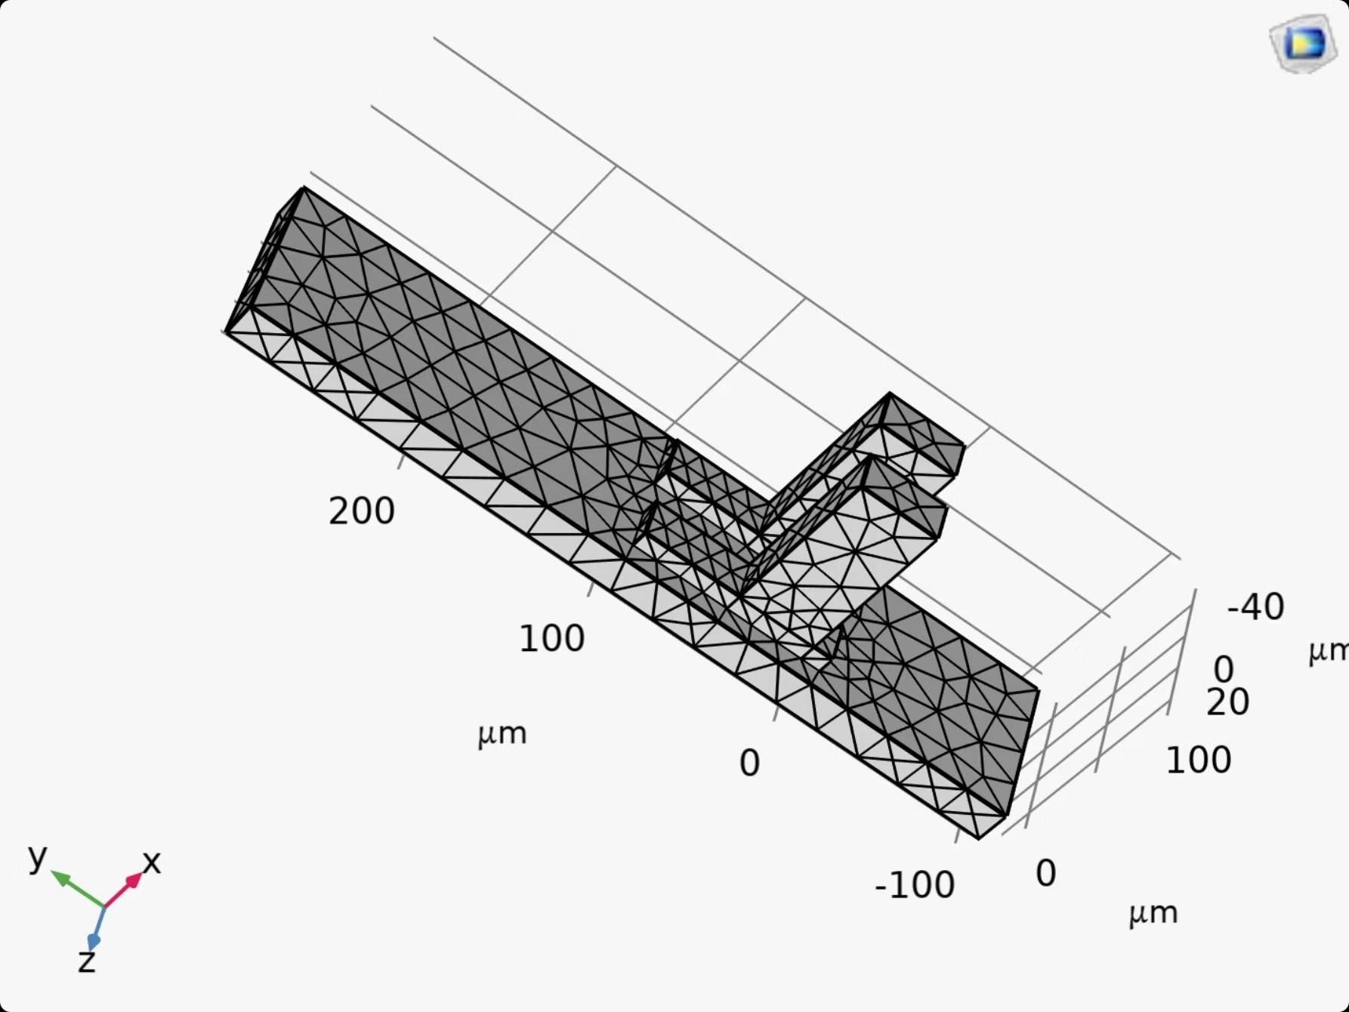
Methodology of the Proposed Work
The methodology for simulating the microgripper in COMSOL Multiphysics involved these key phases:
Dual-Arm FEA Design & Physics
Symmetric Geometry: A 3D dual-arm model was developed in COMSOL, featuring two identical cantilevers
for synchronized micro-gripping.
Material Stack: Each arm utilizes a PZT-5H active actuator base for motion and a
Polysilicon structural beam for mechanical leverage.

Slide 7
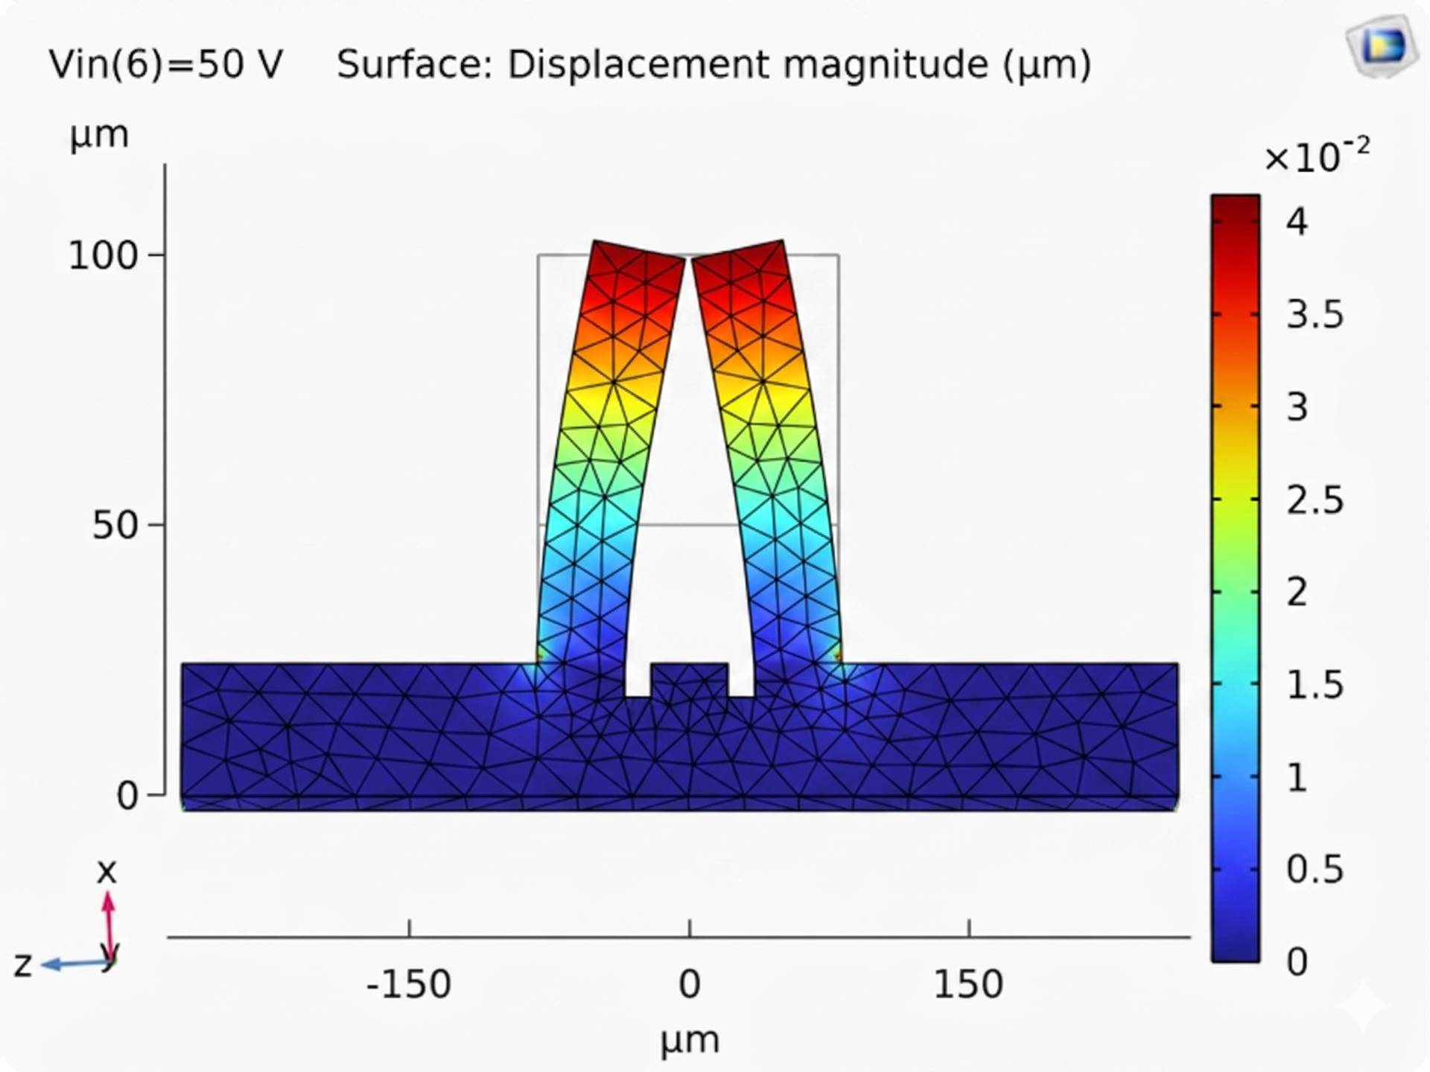
Methodology of the Proposed Work
Multiphysics Coupling: Solid Mechanics and Electrostatics were integrated to simulate the inverse piezoelectric effect under fixed boundary conditions.
Data Generation & Robustness:
Parametric Sweeps: Automated simulations varied V_{in} (0-100V), arm length, and the inter-arm gap to generate thousands of data points.
Stochastic Noise: A 1.8% Additive White Gaussian Noise (AWGN) was injected into the dataset to simulate real-world industrial sensor uncertainty.
Target Output: The model extracts the total symmetric Reaction Force (RF_x) generated during contact with rigid micro-objects.
>>2-D Image of our Micro-Gripper explaining the pinching motion.

Slide 8
Methodology of the Proposed Work
Machine Learning Framework:
Surrogate Modeling: A Random Forest regressor algorithm was developed to replace the high computational latency of the dual-arm FEA solver.
Input Mapping: The framework maps four critical features—Voltage, Arm Length, Gap Distance, and Width—directly to the predicted Grip Force.
Model Training: The system was trained on the noise-augmented dataset to ensure high reliability in stochastic industrial assembly environments.

Slide 9
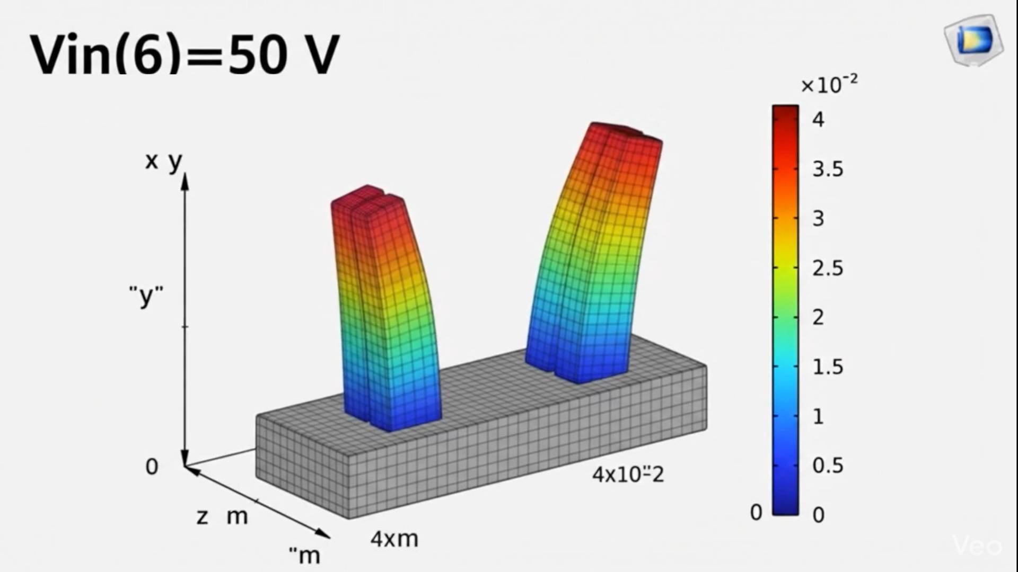
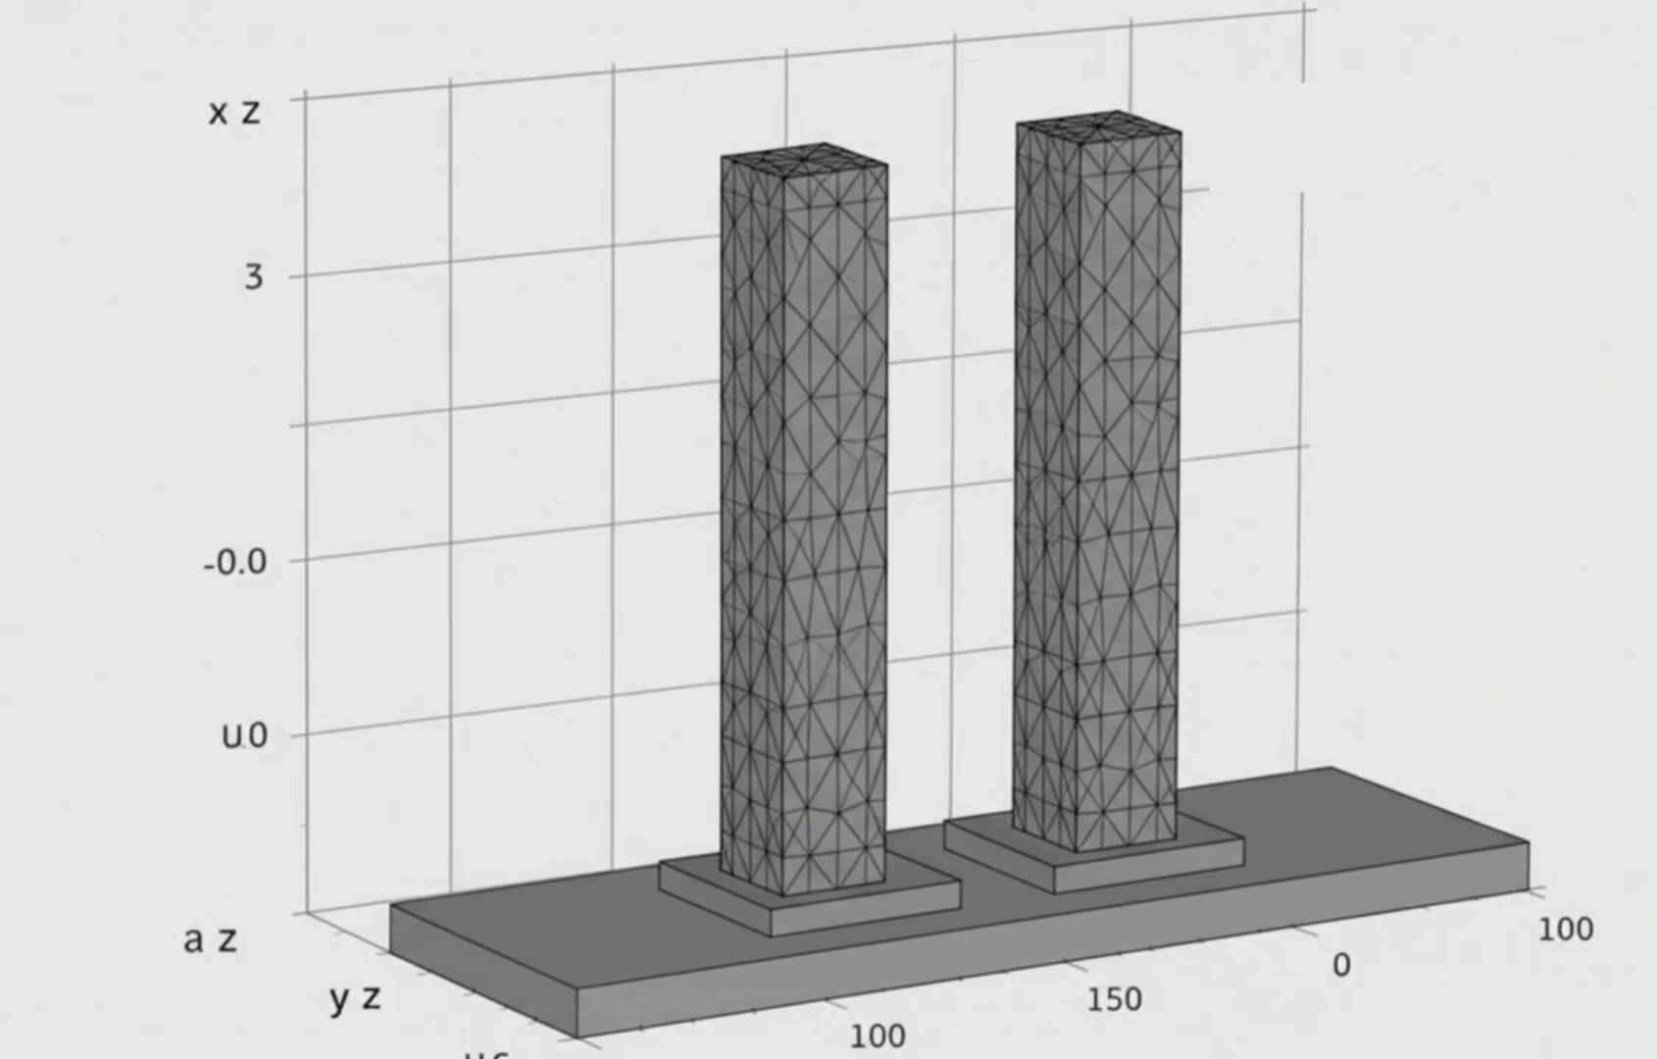
Animations and Working:
Displacement Analysis: The COMSOL Multiphysics simulation visually validates the structural
deformation and displacement magnitude during actuation.
Kinematic Verification: Demonstrates the smooth, continuous transition of the MEMS structure
from an unpowered vertical state to a deformed gripping state.
Mesh & Structural Integrity: The triangular mesh model verifies that the applied physical forces
result in the intended inward leaning motion without structural failure.

Slide 10
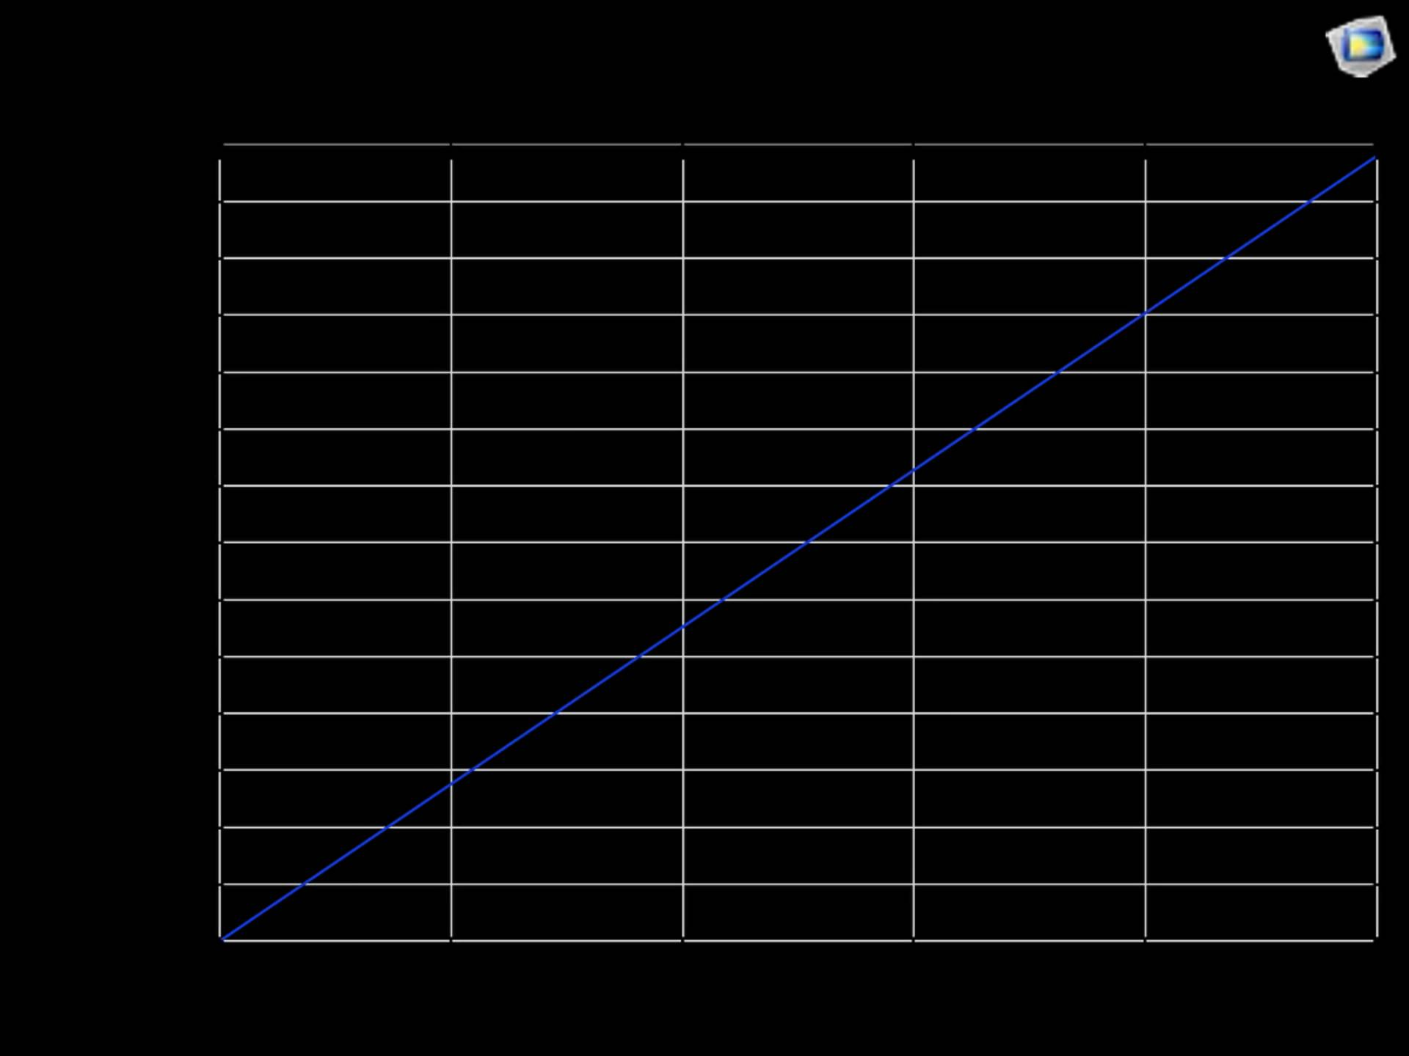
Results and Main Focus
Dual-Arm Force Dynamics: 3D COMSOL simulations confirm that each arm generates a lateral force of 138 µN, providing a combined symmetric "pinch" force for stable micro-object stabilization.
Displacement Precision: The synchronized inward bending of the two Polysilicon arms eliminates the object-sliding issues inherent in single-cantilever designs.
Structural Reliability: The use of the PZT-5H/Polysilicon bimorph stack ensures the high-yield precision required for damage-free handling of micro-lenses and optical fibers.

Slide 11
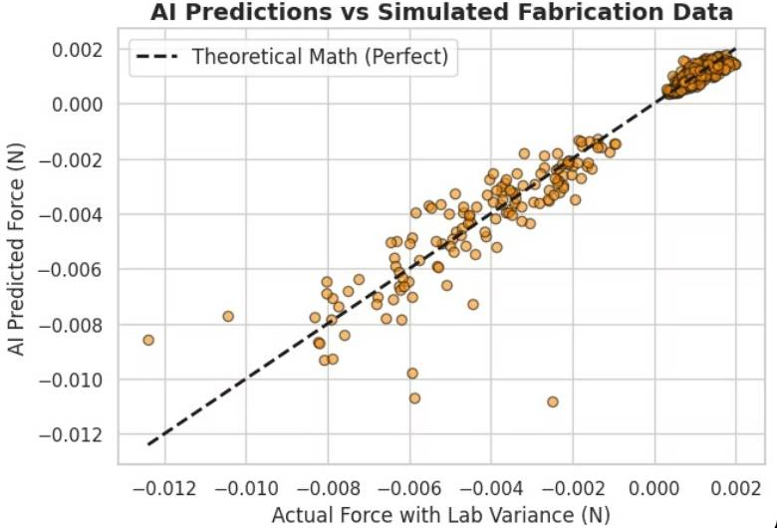
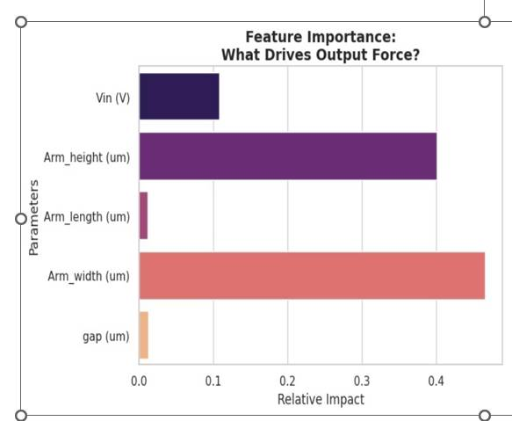
Results and Main Focus
Predictive Accuracy: The ML surrogate model achieved an R^2 value of 0.935, maintaining near-perfect precision even after the injection of 1.8% stochastic noise to simulate real-world sensor uncertainty.
Latency Reduction: Computational time was slashed from ~15 minutes per FEA run to sub-millisecond ML predictions, enabling real-time force control in high-speed assembly.
Model Robustness: The Random Forest framework effectively maps the complex non-linear relationship between dual-arm geometry and resulting grip force, bypassing traditional simulation bottlenecks.

Slide 12
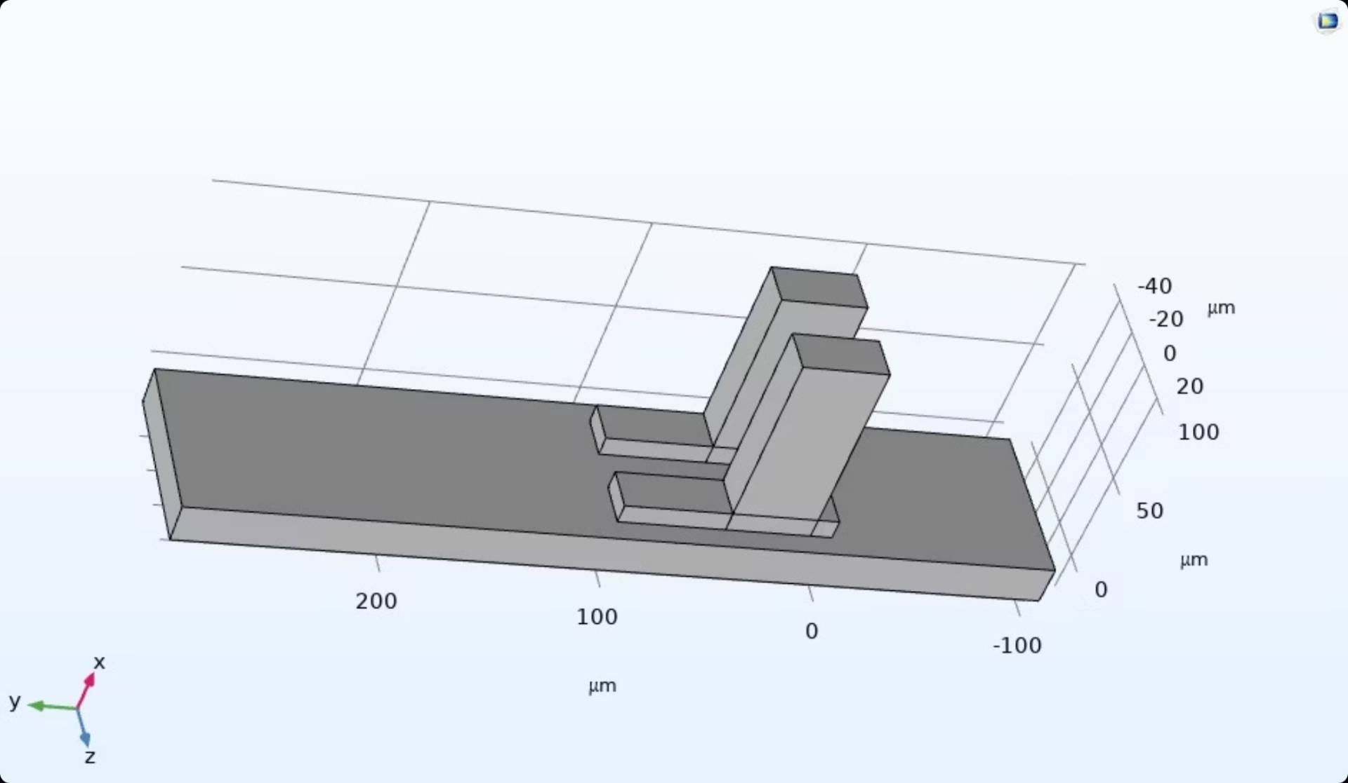
Discussions
The dual-arm configuration provides a synchronized "pinch" force that eliminates object slippage inherent in single-arm models, with each arm generating a lateral blocking force of 138 µN—an ideal safety threshold for handling delicate micro-optical fibers without structural damage. The integrated Random Forest surrogate model demonstrates high robustness, achieving an R^2 accuracy of 0.935 despite the 1.8% stochastic noise injected to simulate real-world sensor uncertainty. By reducing force estimation latency from 15 minutes in FEA to sub-millisecond ML predictions, the system enables high-speed, real-time control for high-throughput Micro-Opto-Electronic assembly lines.

Slide 13
Conclusions and Future Scope
Conclusions
Future Scope
Successfully developed a noise-resilient, dual-arm ML framework that enables the safe, real-time manipulation of delicate components in Micro-Opto-Electronic Assembly.
Scaling the ML model into closed-loop robotic systems for the automated manufacturing of high-precision fiber-optics and smartphone camera modules.
Fabrication:
Physical prototyping using Surface Micromachining (DRIE) and sol-gel PZT deposition to validate the ML-predicted forces against experimental hardware results.

Slide 14
References.
B. Mourched et al., "Design and Simulation of a Piezoelectric MEMS Microgripper for Biological Cell Manipulation," Appl. Sci., vol. 12, no. 19, p. 9798, 2022.
S. Kaur et al., "Design and Analysis of Piezoelectric MEMS Microgripper," Microelectronics & Solid-State Electronics, vol. 2, no. 3, pp. 39-44, 2013.
R. Verma et al., "Design and Simulation of MEMS Based Piezoelectric Microgripper," IJECT, vol. 7, 2016.
M. Botta, "Varied voltage distributions across active piezoelectric MEMS layers for trajectory control," Micromachines, vol. 13, p. 1888, 2022.
Z. Yang and T. Xu, "Integrated blocking force prediction in MEMS devices for safe manipulation," ResearchGate, 2016.
D. Munro et al., "MEMS Fabrication Process," DIY MEMS, 2019.

